Slide 1
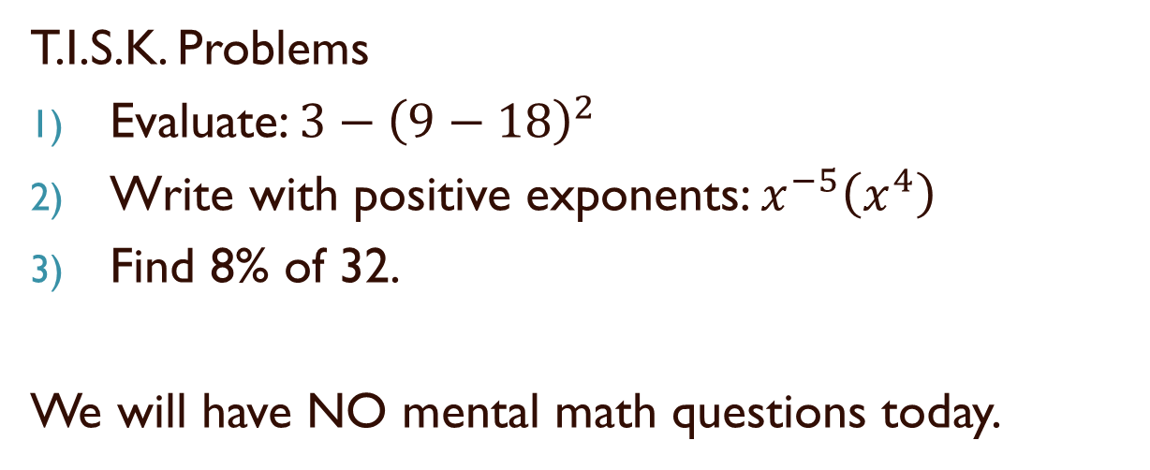
Thursday, August 30, 2012
T.I.S.K. Problems
Evaluate: $3−{\left(9−18\right)}^{2}$
Write with positive exponents: $x^{−5}\left(x^{4}\right)$
Find 8% of 32.
We will have NO mental math questions today.
Homework: p. 111-113 Complete #15-26 mentally; complete #27-31 odd, 34 & 35 in writing

Slide 2
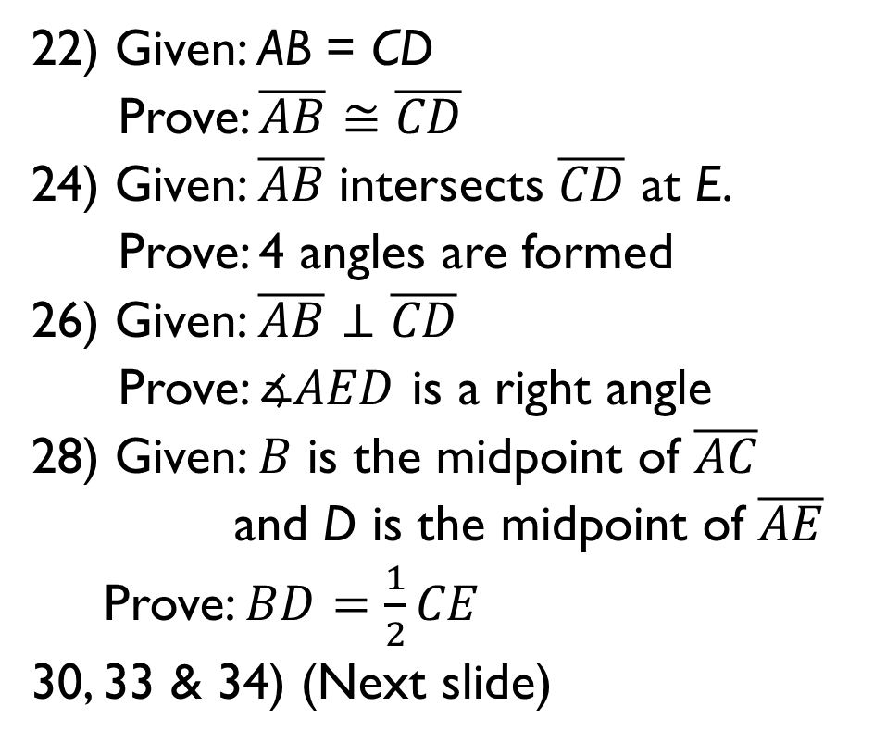
Homework Check
A
B
22) Given: AB = CD
Prove: $\overline{AB}≅\overline{CD}$
24) Given: $\overline{AB}$intersects $\overline{CD}$ at E.
Prove: 4 angles are formed
26) Given: $\overline{AB}⊥\overline{CD}$
Prove: $∡AED$ is a right angle
28) Given: $B$ is the midpoint of $\overline{AC}$
and D is the midpoint of $\overline{AE}$
Prove: $BD=\frac{1}{2}CE$
30, 33 & 34) (Next slide)
C
D
A
D
C
E
A
B
D
C
E
A
B
B
D
C
E

Slide 3
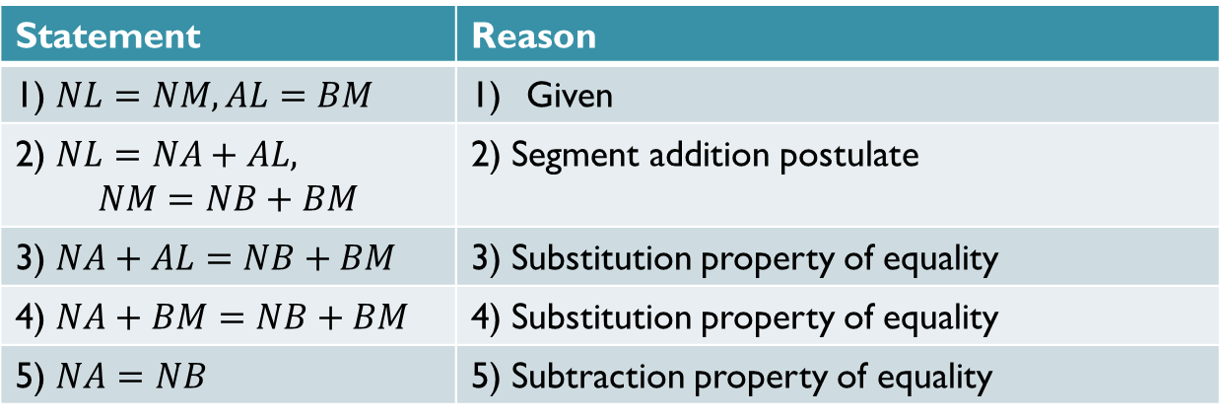
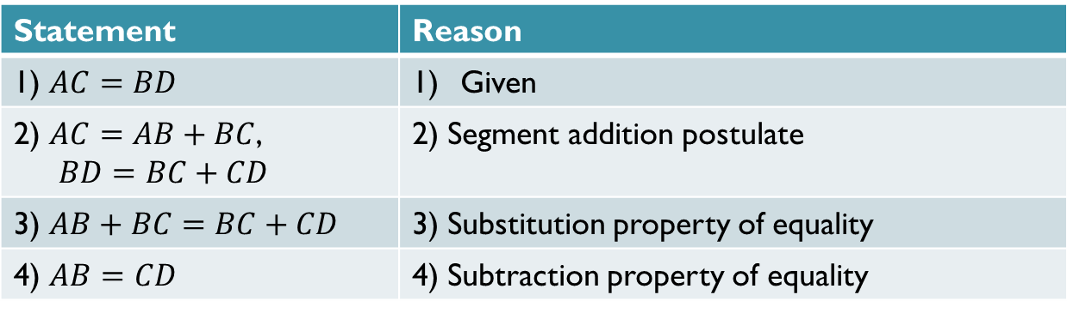
Homework Check
30)
Statement | Reason
1) $AC=BD$ | Given
2) $AC=AB+BC$, $BD=BC+CD$ | 2) Segment addition postulate
3) $AB+BC=BC+CD$ | 3) Substitution property of equality
4) $AB=CD$ | 4) Subtraction property of equality
33)
Statement | Reason
1) $NL=NM, AL=BM$ | Given
2) $NL=NA+AL,$ $$NM=NB+BM$$ | 2) Segment addition postulate
3) $NA+AL=NB+BM$ | 3) Substitution property of equality
4) $NA+BM=NB+BM$ | 4) Substitution property of equality
5) $NA=NB$ | 5) Subtraction property of equality

Slide 4
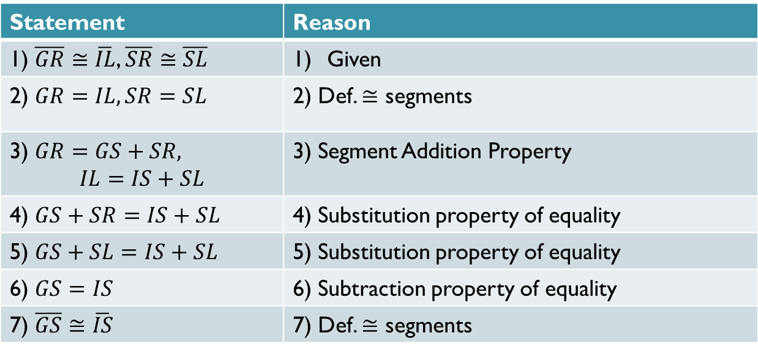
Homework Check
34)
Statement | Reason
1) $\overline{GR}≅\overline{IL}$, $\overline{SR}≅\overline{SL}$ | Given
2) $GR=IL, SR=SL$ | 2) Def. $≅$ segments
3) $GR=GS+SR,$ $$IL=IS+SL$$ | 3) Segment Addition Property
4) $GS+SR=IS+SL$ | 4) Substitution property of equality
5) $GS+SL=IS+SL$ | 5) Substitution property of equality
6) $GS=IS$ | 6) Subtraction property of equality
7) $\overline{GS}≅\overline{IS}$ | 7) Def. $≅$ segments

Slide 5
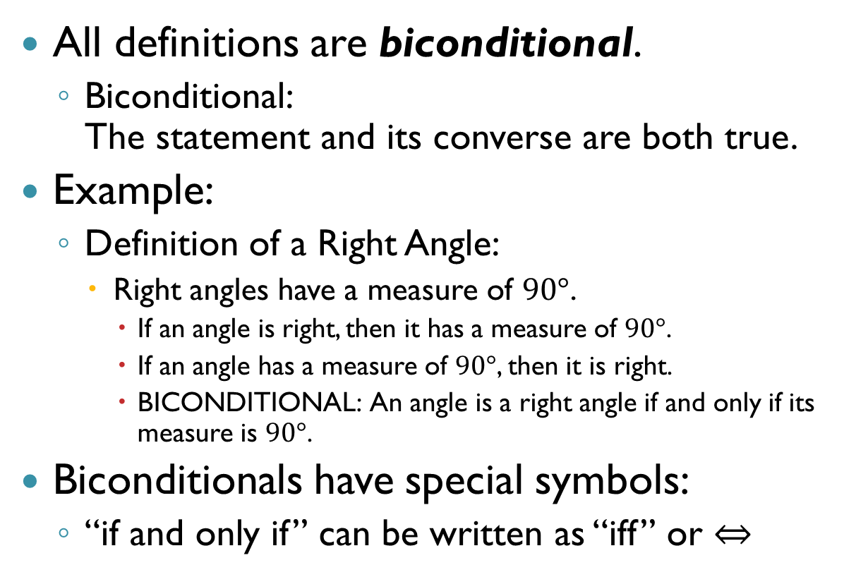
§2-6 Verifying Angle Relationships
All definitions are biconditional.
  Biconditional:
  The statement and its converse are both true.
Example:
  Definition of a Right Angle:
    Right angles have a measure of $90°$.
      If an angle is right, then it has a measure of $90°$.
      If an angle has a measure of $90°$, then it is right.
      BICONDITIONAL: An angle is a right angle if and only if its measure is $90°$.
Biconditionals have special symbols:
  “if and only if” can be written as “iff” or $⇔$

Slide 6
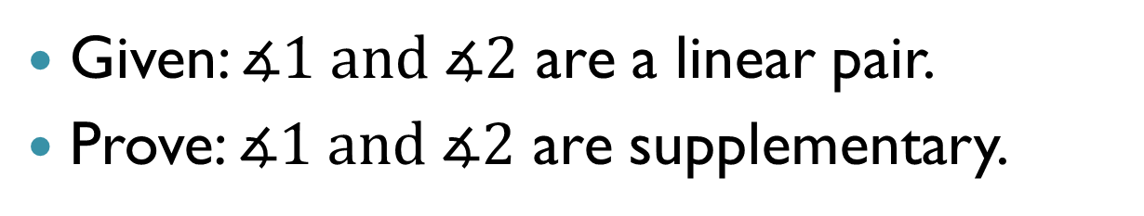
§2-6 Verifying Angle Relationships
Given: $∡1 and ∡2$ are a linear pair.
Prove: $∡1 and ∡2$ are supplementary.
Step 1: Draw a Picture!
1
2
Step 2: Make a plan!
What sort of definitions, theorems, postulates, etc. do I have that deal with Linear Pairs (given) or supplementary angles (goal)?
Linear Pair Postulate:
If two angles form a linear pair then the sum of their measures is $180°$.
Definition of Supplementary:
2 angles are supplementary iff the sum of their measures is $180°$.

Slide 7
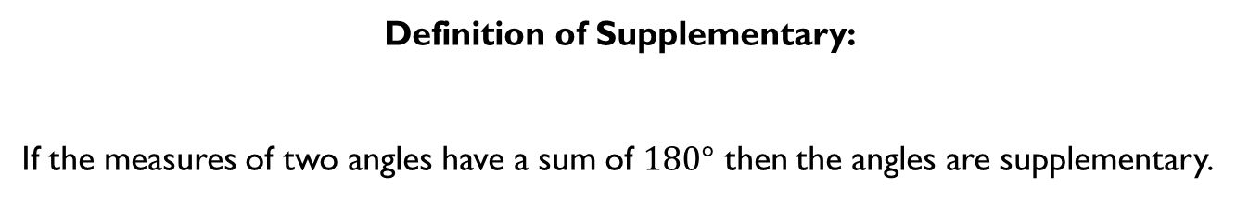
§2-6 Verifying Angle Relationships
Given: $∡1 and ∡2$ are a linear pair.
Prove: $∡1 and ∡2$ are supplementary.
1
2
$∴$ to prove two angles are supplementary, I have to prove they have a sum of $180°$.
Definition of Supplementary:
If the measures of two angles have a sum of $180°$ then the angles are supplementary.

Slide 8
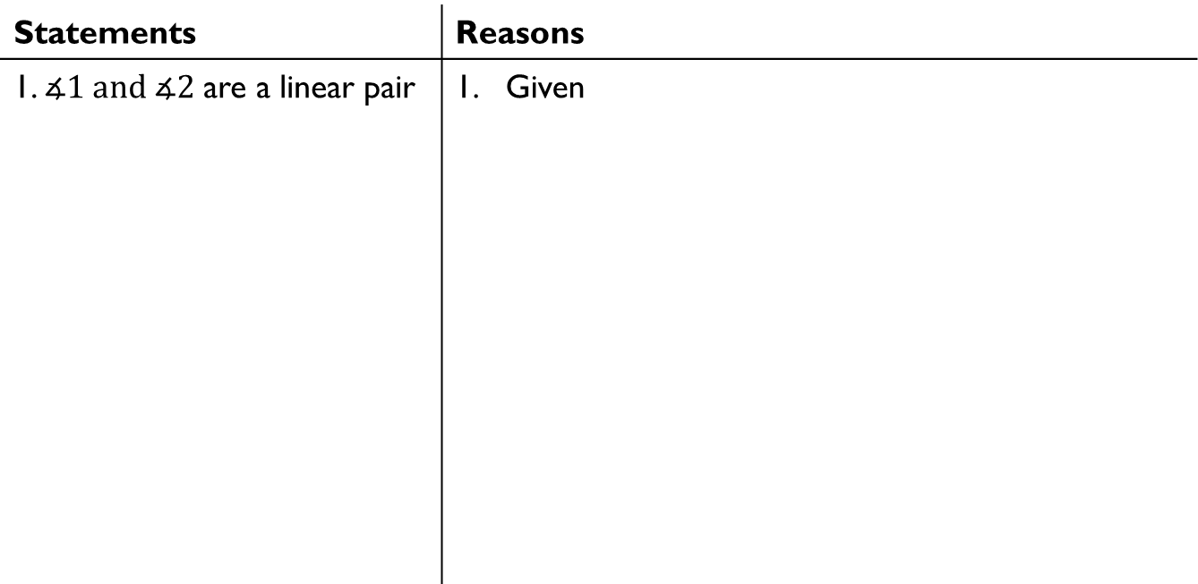
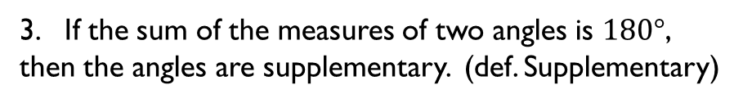

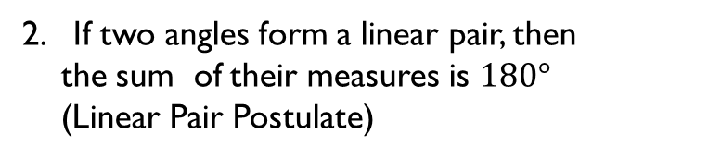

§2-6 Verifying Angle Relationships
Given: $∡1 and ∡2$ are a linear pair.
Prove: $∡1 and ∡2$ are supplementary.
1
2
Statements | Reasons
1. $∡1 and ∡2$ are a linear pair | Given
2. $m∡1+ m∡2=180°$
2. If two angles form a linear pair, then
the sum of their measures is $180°$
(Linear Pair Postulate)
3. $∡1and ∡2$ are supplementary
3. If the sum of the measures of two angles is $180°$, then the angles are supplementary. (def. Supplementary)
You have just proven the Supplement Theorem:
If two angles form a linear pair, then they are supplementary angles.

Slide 9
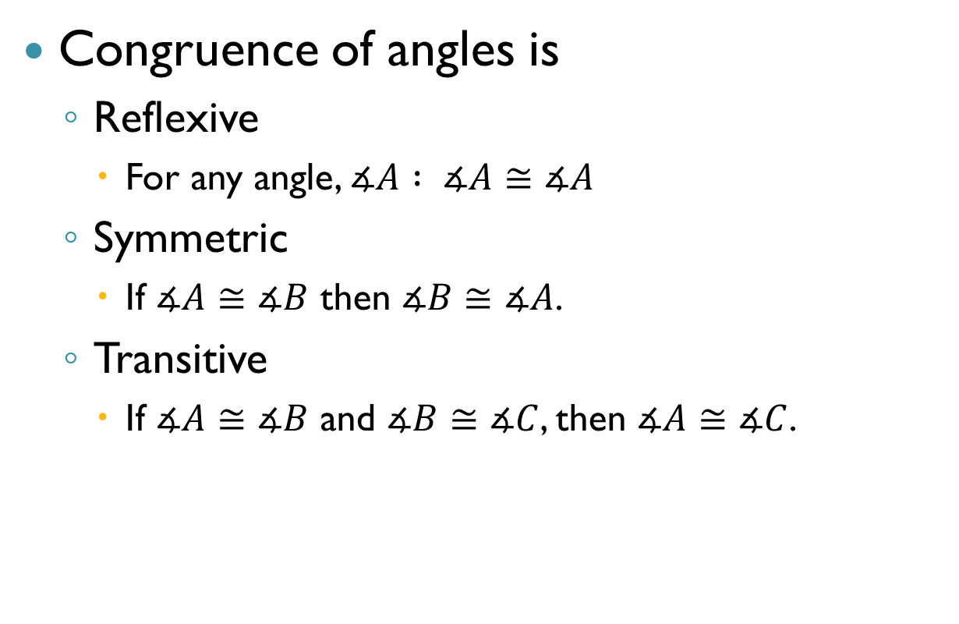
Congruence Theorems
Congruence of angles is
  Reflexive
    For any angle, $∡A : ∡A≅∡A$
  Symmetric
    If $∡A≅∡B$ then $∡B≅∡A$.
  Transitive
    If $∡A≅∡B$ and $∡B≅∡C$, then $∡A≅∡C$.

Slide 10
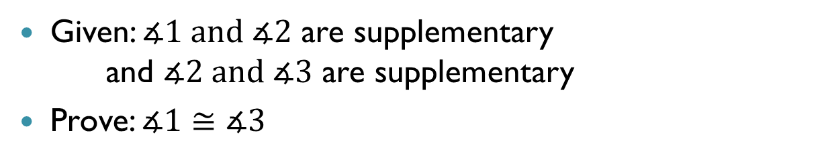
Congruent Supplements Theorem
    Given: $∡1 and ∡2$ are supplementary
    and $∡2 and ∡3$ are supplementary
    Prove: $∡1≅∡3$
2
3
1
To prove angles are congruent, we must prove that they have the same measures.
I know that the sum of the measures of supplementary angles is $180°$.

Slide 11

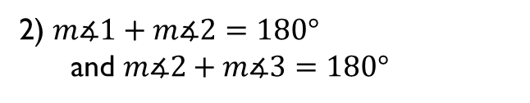

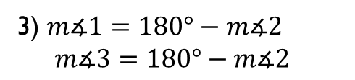
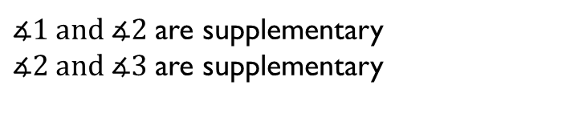
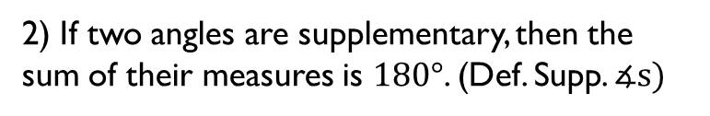
Congruent Supplements Theorem
    Given: $∡1 and ∡2$ are supplementary
    and $∡2 and ∡3$ are supplementary
    Prove: $∡1≅∡3$
2
3
1
Congruent Supplements Theorem: If two angles are supplementary to the same angle (or congruent angles) then they are congruent.
Statements | Reasons
1) | 1) Given
    $∡1 and ∡2$ are supplementary
    $∡2 and ∡3$ are supplementary
    2) $m∡1+m∡2=180°$
    and $m∡2+m∡3=180°$
    2) If two angles are supplementary, then the sum of their measures is $180°$. (Def. Supp. $∡s)$
    3) $m∡1=180°−m∡2$
    $m∡3=180°−m∡2$
    3) If a = b then a – c = b – c . (- prop. of =)
    4) $m∡1=m∡3$
    4) If a = b and b = c then a = c. (Transitive prop.)
    5) $∡1≅∡3$
    5) If 2 $∡$s have = measures, then they’re $≅$ (def. $≅$ )

Slide 12
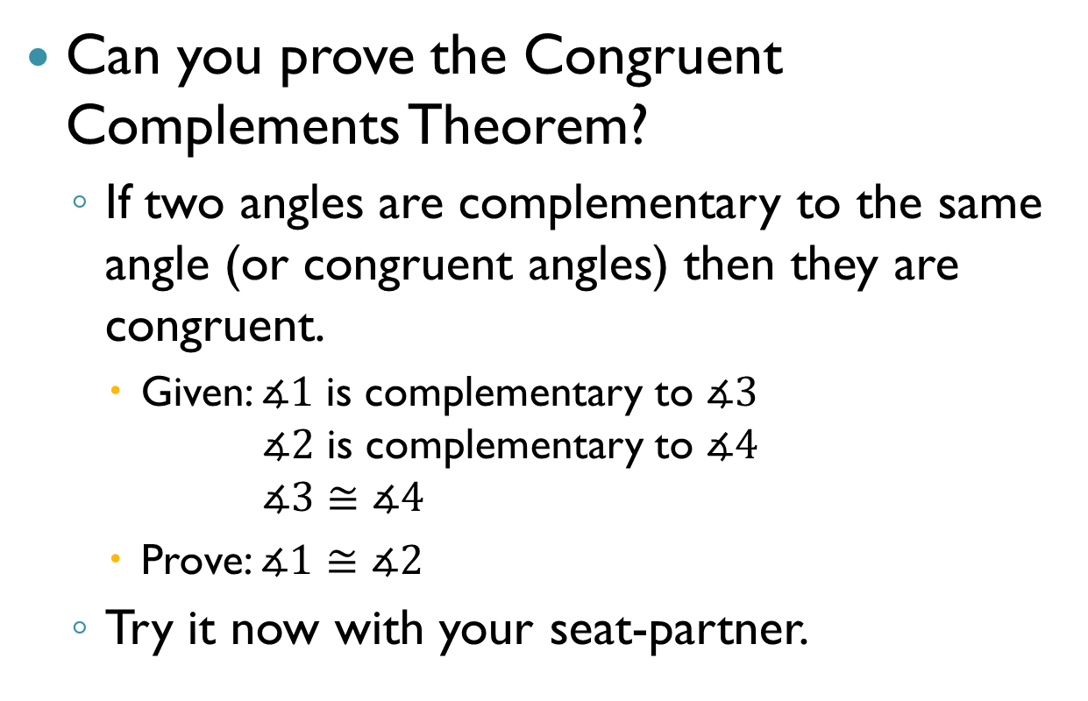
Congruent Complements Theorem
Can you prove the Congruent Complements Theorem?
  If two angles are complementary to the same angle (or congruent angles) then they are congruent.
    Given: $∡1$ is complementary to $∡3$
    $∡2$ is complementary to $∡4$
    $∡3≅∡4$
    Prove: $∡1≅∡2$
  Try it now with your seat-partner.

Slide 13


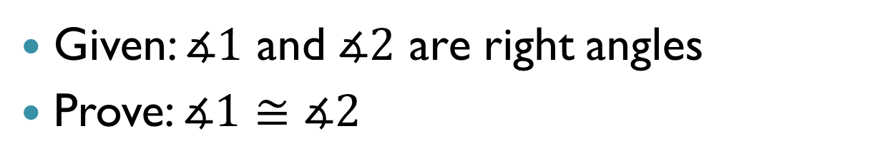

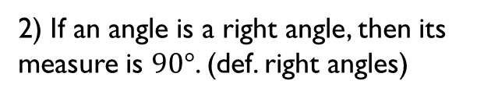

Right Angle Theorem
Given: $∡1$ and $∡2$ are right angles
Prove: $∡1≅∡2$
2
1
Statement | Reason
1) | Given
$∡1$ and $∡2$ are right angles
2) $m∡1=90°$ and $m∡2=90°$
2) If an angle is a right angle, then its measure is $90°$. (def. right angles)
3) $m∡1=$ $m∡2$
3) If a = b and b = c then, a = c. (Transitive prop.)
4) $∡1≅$ $∡2$
    4) If 2 $∡$s have = measures, then they’re $≅$ (def. $≅$ )
Right Angle Theorem
If 2 (or more) angles are right angles then they are congruent.

Slide 14
Prove the Vertical Angle Theorem
If two angles are vertical angles,
then they are congruent.

Slide 15
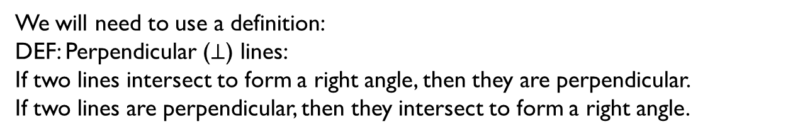
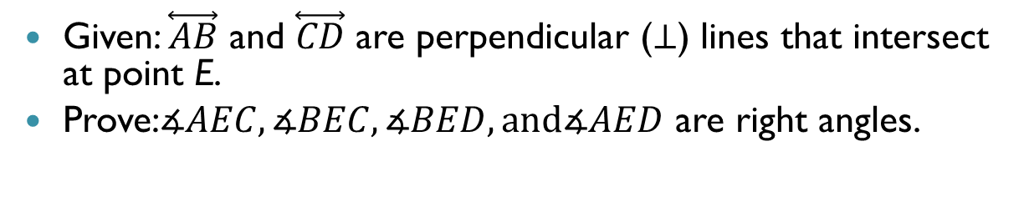
One More Theorem
Given: $\overset{⃡}{AB}$ and $\overset{⃡}{CD}$ are perpendicular ($⊥$) lines that intersect at point E.
Prove:$∡AEC,∡BEC,∡BED, and∡AED$ are right angles.
A
D
C
E
B
We will need to use a definition:
DEF: Perpendicular ($⊥$) lines:
If two lines intersect to form a right angle, then they are perpendicular.
If two lines are perpendicular, then they intersect to form a right angle.
We also use the Vertical Angle Theorem:
If two angles are vertical angles, then they are congruent.

Slide 16


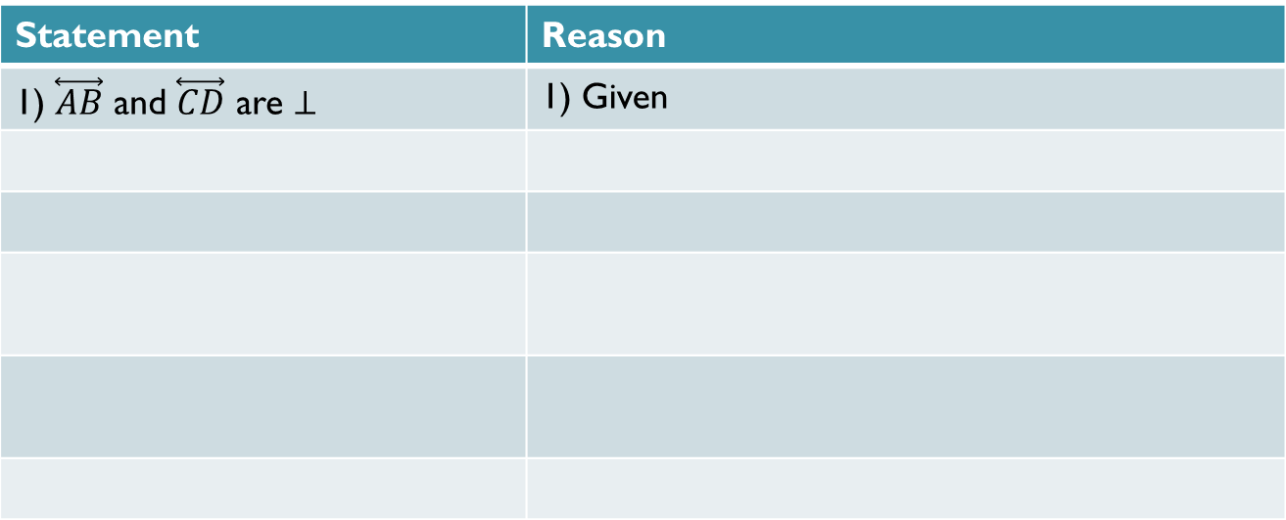
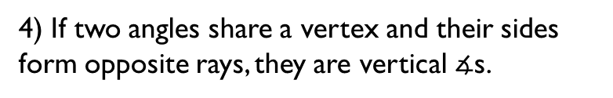

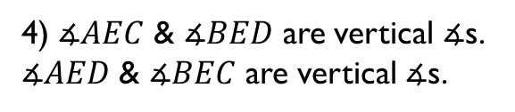


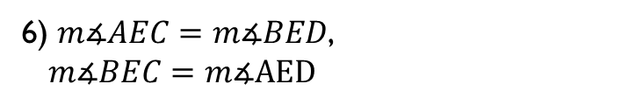


One More Theorem
Given: $\overset{⃡}{AB}$ and $\overset{⃡}{CD}$ are perpendicular ($⊥$) lines that intersect at point E.
Prove:$∡AEC,∡BEC,∡BED, and∡AED$ are right angles.
A
D
C
E
B
Statement | Reason
1) $\overset{⃡}{AB}$ and $\overset{⃡}{CD}$ are $⊥$ | 1) Given
2) $∡AEC$ is a right $∡$.
2) If two lines are $⊥$ then they form a right $∡$.
3) $m∡AEC=90°$
3) If an $∡$is right, then its measure = $90°$.
4) $∡AEC$ & $∡BED$ are vertical $∡$s.
$∡AED$ & $∡BEC$ are vertical $∡$s.
4) If two angles share a vertex and their sides form opposite rays, they are vertical $∡$s.
5) $∡AEC≅∡BED$, $∡BEC≅∡AED$
5) If two angles are vertical $∡$s, then they’re $≅$.
6) $m∡AEC=m∡BED$,
$m∡BEC=m∡AED$
6) If 2 $∡$s are $≅$ then they have = measures.

Slide 17
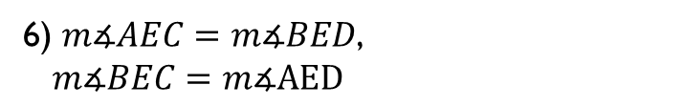


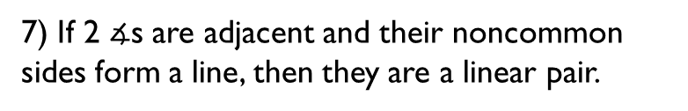




One More Theorem
Given: $\overset{⃡}{AB}$ and $\overset{⃡}{CD}$ are perpendicular ($⊥$) lines that intersect at point E.
Prove:$∡AEC,∡BEC,∡BED, and∡AED$ are right angles.
A
D
C
E
B
Statement | Reason
6) $m∡AEC=m∡BED$,
$m∡BEC=m∡AED$
6) If 2 $∡$s are $≅$ then they have = measures.
7) $∡AEC and ∡AED$ are a linear pair
7) If 2 $∡$s are adjacent and their noncommon sides form a line, then they are a linear pair.
8) $∡AEC and ∡AED$ are supp.
8) If 2 $∡$s form a linear pair, then they’re supp.
9) $m∡AEC+m∡AED=180°$
9) If 2 $∡$s are supp., then the sum of their measures is 180$°$
10) $90°+m∡AED=180°$
10) If a = b, then a can be substituted for b in any equation.
11) $m∡AED=90°$
11) If a = b then a – c = b – c.

Slide 18


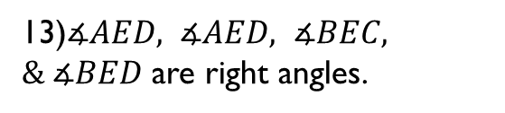
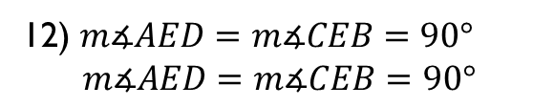
One More Theorem
Given: $\overset{⃡}{AB}$ and $\overset{⃡}{CD}$ are perpendicular ($⊥$) lines that intersect at point E.
Prove:$∡AEC,∡BEC,∡BED, and∡AED$ are right angles.
A
D
C
E
B
Statement | Reason
11) $m∡AED=90°$
11) If a = b then a – c = b – c.
12) $m∡AED=m∡CEB=90°$
$m∡AED=m∡CEB=90°$
12) If a = b and b = c, then a = c.
13)$∡AED, ∡AED, ∡BEC, \& ∡BED$ are right angles.
13)If the $m∡=90°$, then it is a right angle.
Theorem:
Perpendicular lines intersect to form four right angles.

Slide 19
Homework
p. 111-113 Complete #15-26 mentally; complete #27-31 odd, 34 & 35 in writing

